Slide 1
SAS Array

Slide 2
CONCEPTS TO COVER
SAS Array Concept
SAS Array Syntax
SAS Array Declaration
SAS Array Operators

Slide 3
What is Array in SAS?
SAS array groups similar variables for processing inside the data step. After SAS array is defined, the tasks performed by variables at different times can be performed using a single array. This saves time and does not require multiple statements to be written.

Slide 4
SAS Array Syntax
The SAS ARRAY statement consists of the keyword ARRAY followed by the name of the array:
ARRAY array_name[ ];
The SAS array name can be followed by either a pair of parentheses ( ), braces { }, or square brackets [ ]. By specifying a value inside the bracket, we can assign the same number of variables to the array.
For example – using the same example used above, we can create an array income and add 12 variables to it, one for each month, instead of writing statements for those 12 variables.
ARRAY income[12] inc1-inc12;
In this statement, the array income has 12 variables (inc1–inc12) associated with it.

Slide 5
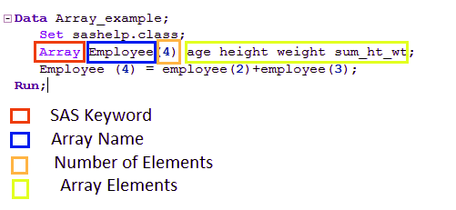
BASIC SAS EXAMPLE

Slide 6
Examples of SAS Array Declaration
# Declare an array of length 4 named age with values.
ARRAY age[4] (11 1 2 62);
# Declare an array of length 8 named colors with values starting at index 0.
ARRAY colors (0:8) A B C D E F G H I;
# Declare an array of length 5 named books which contain character values.
ARRAY books(1:5) $ b1-b5;
# Declare an array of required length depending on the number of values supplied.
ARRAY ANS(*) A1-A10;

Slide 7
Points to Remember
There are some important points, which you should remember while working on SAS Array. SAS Variables that are associated with an array have certain characteristics:
All variables that are defined inside an array should be of the same type. They can be either numeric or character variables.
If the variables are character variables, a dollar ($) sign must be placed after the defining the array.
Example –
array my_name[3] $ first middle last;
By default, variables inside the array have a length of 8 bytes. To specify a different length for the variables, include the desired length after the $ for character arrays and after the brackets for numeric arrays.
Example –
array name[3] $12 first last middle;

Slide 8
SAS Array Operations
SAS Array Operators
Here, we talk about two types of Array Operators in SAS: OF Operators and IN Operators.
1. SAS OF Operator
We use the OF operator when a calculation is to be performed on all the variables or elements of the array.
DATA example_OF;
INPUT A1 A2 A3 A4;
ARRAY A(4) A1-A4;
A_SUM=SUM(OF A(*));
A_MEAN=MEAN(OF A(*));
A_MIN=MIN(OF A(*));
DATALINES;
21 4 52 11
96 25 42 6;
RUN;
PROC PRINT DATA=example_OF;
RUN;

Slide 9
SAS IN Operator
If we want to look for a particular value in the array and check for its presence, we can make use of IN operator. In the below example, we will check for the availability of the color “Pink” in the data. The keyword IN is case sensitive.
DATA in_example;
INPUT A1 $ A2 $ A3 $ A4 $;
ARRAY COLOURS(4) A1-A4;
IF 'yellow' IN COLOURS THEN available='Yes'; ELSE available='No';
DATALINES;
Orange-pink violet yellow;
RUN;
PROC PRINT DATA=in_example;
RUN;

Slide 10
Thank you

